Slide 1
Network Fundamentals

Slide 2
Baseband Coaxial Cable
One of the common transmission media.
Usually called as coax.
It has better shielding than twisted pairs, so it can span longer distances at higher speeds.

Slide 3
Coaxial Cable:
Functionally grouped into:
Baseband: Frequency band occupied by a single or composite signal in its original or unmodulated form. The cable is dedicate for only one channel.
Broadband: Using high frequency transmission over medium, several streams of data can be transmitted (at different frequencies) simultaneously.

Slide 4
Baseband Coaxial Cable
One kind, 50-ohm cable, is commonly used for digital transmission.
The other, 70-ohm cable, is commonly used for analog transmission.
A coaxial cable consists of a stiff copper wire as the core, surrounded by an insulating material.

Slide 5
Baseband Coaxial Cable
The insulator is encased by a cylindrical conductor, often as a closely woven braided mesh.
The outer conductor is covered in a protective plastic sheath.
The construction and shielding of the coaxial cable give it a good combination of high bandwidth and excellent noise immunity.

Slide 6
Baseband Coaxial Cable
The bandwidth possible depends on the cable length.
1-km cables, a data rate of 1 to 2 Gbps.
Longer cable can also be used.
Only at lower data rates or with periodic amplifiers.

Slide 7
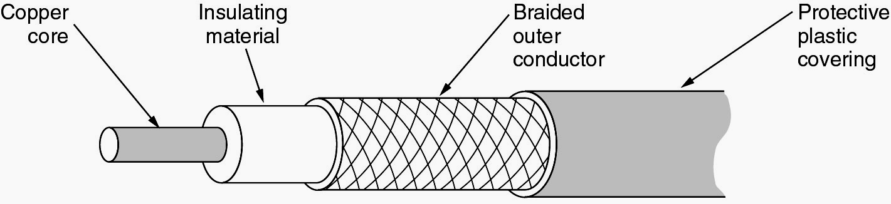
Baseband Coaxial Cable

Slide 8
Baseband Coaxial Cable
It is used widely with the telephone system but have now largely been replaced by fiber optics on long routes.
Coax is still widely used for cable television and some local area networks.

Slide 9
Broadband Coaxial Cable
The other kind of coaxial cable system uses analog transmission.
It is called broadband.
The term “broadband” comes from the telephone world, where it refers to anything wider than 5kHz.

Slide 10
Broadband Coaxial Cable
In the computer networking world “broadband cable” means any cable network using analog transmission.
The cables can be used up to 300 MHz – 450 MHz and can run for nearly 100 km due to the analog signaling.

Slide 11
Broadband Coaxial Cable
One main difference between these two cables is that broadband systems typically cover a large area and therefore need analog amplifiers to strengthen the signal periodically.

Slide 12
FIBER OPTICS
In 1970s, a fast computer could execute an instruction in 100nsec.
Twenty years later, a fast computer could execute an instruction in 1nsec, a factor of 10 improvement per decade.
In the same period, data communication went from 56 kbps (the ARPANET) to 1 Gbps (modern optical communication).

Slide 13
FIBER OPTICS
With current fiber technology, the achievable bandwidth is certainly in excess of 50,000 Gbps (50 Tbps).
Here we will see that using fiber optics how the transmission technology works.
A fiber-optics cable is made of glass or plastic and transmits signals in the form of light.

Slide 14
FIBER OPTICS
An optical transmission system has three components:
The light source
The transmission medium, and
The detector
A present of light indicates a 1 bit and the absence of light indicates a zero bit.

Slide 15
FIBER OPTICS
The transmission medium is an ultra-thin fiber of glass.
The detector generates an electrical pulse when light falls on it.
By attaching a light source to one end of an optical fiber and a detector to the other, we have a unidirectional data transmission system.

Slide 16

FIBER OPTICS
Angle of Incidence (I): the angle the ray makes with the line perpendicular to the interface between the two substances
Critical Angle: the angle of incidence which provides an angle of refraction of 90-degrees.

Slide 17

FIBER OPTICS
Uses reflection to guide light through a channel
Core is of glass or plastic surrounded by Cladding
Cladding is of less dense glass or plastic

Slide 18
FIBER OPTICS
The amount of reflection depends on the properties of the two media.
For angles of incidence above a certain critical value, the light is refracted back into the silica.
Thus a light ray incident at or above the critical angle is trapped inside the fiber and can propagate for many kilometers with virtually no loss.
The light ray incident on the boundary above the critical angle will be reflected internally, many different rays will be bouncing around at different angles.

Slide 19
FIBER OPTICS
Each ray is said to have different mode so a fiber having this property is called multimode fiber.
If the fiber’s diameter is reduced to a few wavelengths of light, the fiber acts like a wave guide, and the light can only propagate in a straight line, without bouncing, yielding a single-mode fiber.

Slide 20
FIBER OPTICS
Single mode fibers are more expensive but can be used for longer distances.
Currently available single-mode fibers can transmit data at several Gbps for 30 km.
Experiments have shown that powerful lasers can drive a fiber 100 km long without repeaters, although at lower speeds.

Slide 21
FIBER OPTICS
Optical fibers are made of glass is made from sand, an inexpensive raw material available in unlimited amounts.
Glass making was known to the ancient Egyptians, but their glass had to be no more than 1 mm thick or the light could not shine through.

Slide 22
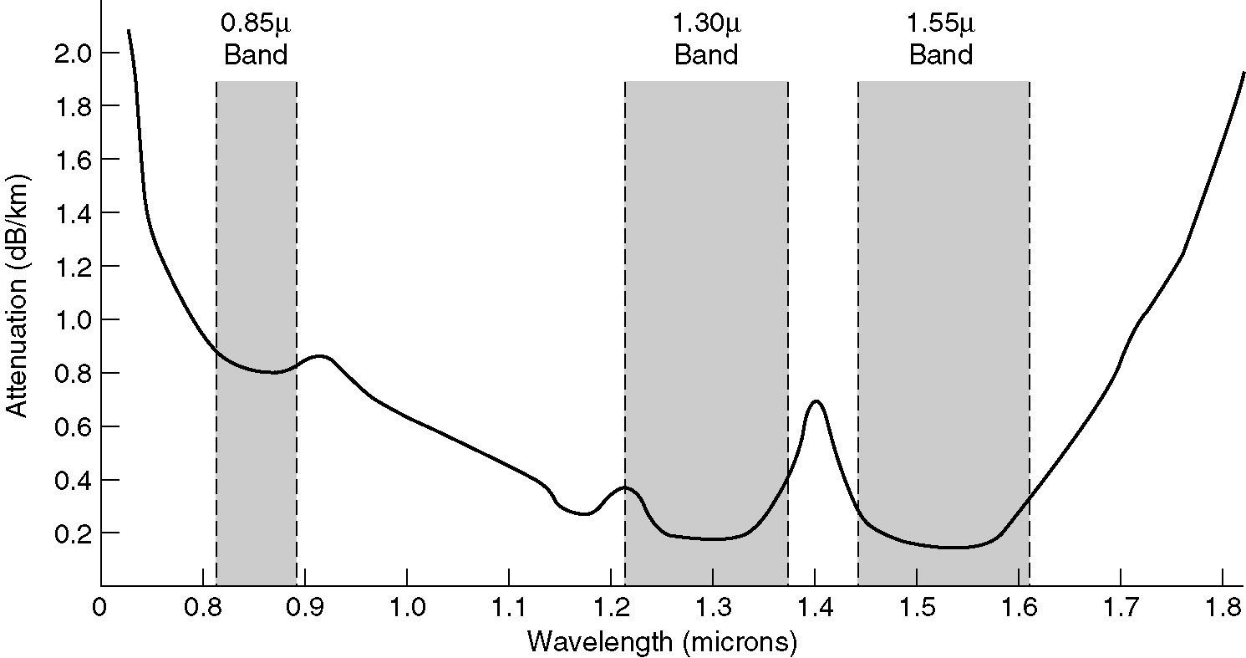
FIBER OPTICS
The attenuation of light through glass depends on the wavelength of the light.

Slide 23
FIBER OPTICS
The attenuation in decibels is given by the formula
Attenuation in decibels = 10 log₁₀ transmitted power / received power

Slide 24
FIBER OPTICS
Fiber optic cables are similar to coax, except without the braid.
At the center is the glass core through which the light propagates.
The multimode fibers, the core is 50 microns in diameter, about the thickness of a human hair.

Slide 25
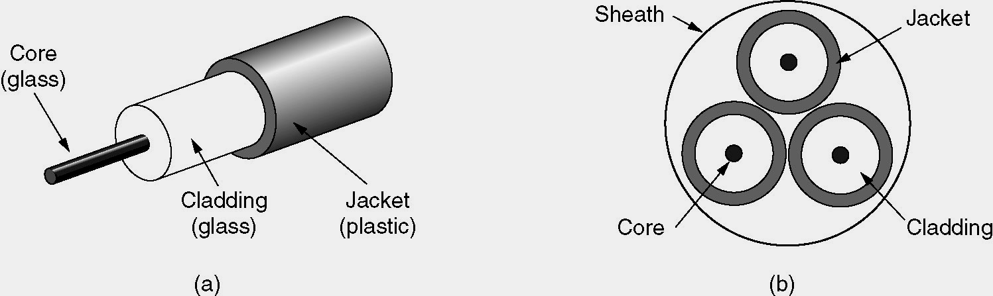
FIBER OPTICS
(a) Side view of a single fiber.
(b) End view of a sheath with three fibers.

Slide 26

FIBER OPTICS

Slide 27

FIBER OPTICS

Slide 28
FIBER OPTICS
In single-mode fibers the core is 8 to 10 microns.
The core is surrounded by a glass cladding with a lower index of refraction than the core, to keep all the light in the core.
Next comes a thin plastic jacket to protect the cladding.

Slide 29
FIBER OPTICS
Fibers are typically grouped together in bundles, protected by an outer sheath.
Fiber can be connected in three different ways.
First, they can terminate in connectors and be plugged into fiber sockets.

Slide 30
FIBER OPTICS
Connectors lose about 10 to 20 percent of the light, but they make it easy to reconfigure systems.
Second, they can be spliced mechanically.
Mechanical splices just lay the two carefully cut ends next to each other in a special sleeve and clamp them in place.

Slide 31
FIBER OPTICS
Alignment can be improved by passing light through the junction and then making small adjustments to maximize the signal.
Mechanical splices take trained personnel about 5 minutes and results in a 10 percent light loss.

Slide 32
FIBER OPTICS
Third, tow pieces of fiber can be fused(melted) to form a solid connection.
A fusion splice is almost as good as a single drawn fiber, but even here, a small amount of attenuation occurs.

Slide 33
FIBER OPTICS
Two kinds of light sources can be used to do the signaling.
LEDs (Light Emitting Diodes)
Semiconductor lasers.
The receiving end of an optical fiber consists of a photodiode, which gives off an electrical pulse when struck by light.

Slide 34
FIBER OPTICS
The typical response time of a photodiode is 1 nsec, which limits data rates to about 1 Gbps.
By making the pulses powerful enough, the error rate can be made arbitrarily small.

Slide 35
FIBER OPTICS (Advantages)
Fiber-optics cable has several advantages over metallic cable(twisted-pair or coaxial)
Higher bandwidth: Fiber-optic cable can support dramatically higher bandwidths than either twisted-pair or coaxial cable.

Slide 36
FIBER OPTICS (Advantages)
Less signal attenuation : Fiber-optic transmission distance is significantly greater than that of other guided media. A signal can run for 50 km without requiring regeneration. We need repeaters every 5 km for coaxial or twisted-pair cable.

Slide 37
FIBER OPTICS (Advantages)
Immunity to electromagnetic interference : Electromagnetic noise cannot affect fiber-optic cables.
Resistance to corrosive materials : Glass is more resistant to corrosive(acidic) materials than copper.

Slide 38
FIBER OPTICS (Advantages)
Light Weight : Fiber-optic cables are much lighter than copper cables.

Slide 39
FIBER OPTICS (Disadvantages)
There are some disadvantages in the use of optical fiber.
Installation/maintenance : Fiber-optic cable is a relatively new technology. Installation and maintenance need expertise that is not yet available everywhere.

Slide 40
FIBER OPTICS (Disadvantages)
Unidirectional : Propagation of light is unidirectional. If we need bidirectional communication, two fibers are needed.
Cost : The cable and interfaces are relatively more expensive than those of other guided media. If the demand for bandwidth is not high, often the use of optical fiber cannot be justified.

Slide 41
Unguided Media
Unguided media transport electromagnetic waves without using a physical conductor.
This type of communication is often referred to as wireless communication.
Signals are normally broadcast through air and thus are available to anyone who has a device capable of receiving them.

Slide 42
Unguided Media
3 kHz
300 GHz
400 THz
900 THz
Infrared
Light wave
Radio wave and microwave
Electromagnetic spectrum for wireless communication

Slide 43
Unguided Media
Unguided signals can travel from the source to destination in several ways.
There is ground propagation (below 2 MHz), sky propagation (2-30 MHz) and line-of-sight propagation (above 30 MHz).

Slide 44
Unguided Media
In ground propagation, radio waves travel through the lowest portion of the atmosphere.
These low-frequency signals originate in all directions from the transmitting antenna and follow the curvature of the planet.
Distance depends on the amount of power in the signal. The greater the power, the greater the distance.

Slide 45
Unguided Media
In sky propagation, higher-frequency radio waves radiate upward into the ionosphere (the layer of atmosphere where particles exist as ions) where they are reflected back to earth. This transmission allows for greater distances with lower power output.

Slide 46
Unguided Media
In line-of-sight propagation, very high-frequency signals are transmitted in straight lines directly from antenna to antenna.
Antennas must be directional, facing each other, and either tall enough or close enough together not to be affected by the curvature of the earth.

Slide 47
Unguided Media
The electromagnetic spectrum defined as radio waves and microwaves is divided into eight ranges, called bands, each regulated by government authorities.

Slide 48
Unguided Media
These bands are rated from very low frequency (VLF) to extremely high frequency (EHF).

Slide 49
Unguided Media
Lists of these bands, their ranges, propagation methods, and some applications are as follows.
BandTable.htm

Slide 50
Unguided Media
We can divide wireless transmission into three broad groups:
Radio waves
Microwaves
Infrared waves

Slide 51
Radio Waves
The electromagnetic waves ranging in frequencies between 3 KHz and 1 GHz are normally called radio waves.
Radio waves, for the most part, are omni directional.

Slide 52
Radio Waves
When an antenna transmits radio waves, they are propagated in all directions.
This means that the sending and receiving antennas do not have to be aligned.

Slide 53
Radio Waves
A sending antenna can send waves that can be received by any receiving antenna.
Radio waves, particularly those waves that propagate in the sky mode, can travel long distances.

Slide 54
Radio Waves
This makes radio waves a good candidate for long-distance broadcasting such as AM radio.
Radio waves, particularly those of low and medium frequencies, can penetrate walls.

Slide 55
Radio Waves
This characteristic can be both an advantage and disadvantage.
It is the advantage because, for example an AM radio can receive signals inside a building.

Slide 56
Radio Waves
It is a disadvantage because we cannot isolate a communication to just inside or outside a building.
The radio wave band is relatively narrow, just under 1 GHz, compared to the microwave band.

Slide 57
Radio Waves
Almost the entire band is regulated by authorities.
Using any part of the band requires permission from the authorities.

Slide 58
Omni directional Antenna
Radio waves use omni directional antennas that send out signals in other directions.
Based on wavelength, strength, and the purpose of transmission, we can have several types of antennas.

Slide 59
Omni directional Antenna
Application : The omni directional characteristics of the radio waves make them useful for multicasting, in which there is one sender but many receivers. AM and FM radio, television, cordless phones are the example of multicasting.

Slide 60
Microwaves
Electromagnetic waves having frequencies between 1 and 300 GHz are called microwaves.
Microwaves are unidirectional.
When antenna transmits microwave waves, they can be narrowly focused.
This means that the sending and receiving antennas need to be aligned.

Slide 61
Microwaves
The unidirectional property has an obvious advantage.
A pair of antennas can be aligned without interfering with another pair of aligned antennas.
Microwave propagation is line-of-sight.

Slide 62
Microwaves
Since the towers with the mounted antennas need to be in direct sight of each other, towers that are far apart need to be vary tall.
The curvature of the earth as well as other blocking obstacles do not allow two short towers to communicate using microwaves.

Slide 63
Microwaves
Repeaters are often needed for long-distance communication.
Very high-frequency microwaves cannot penetrate walls.
This characteristic can be a disadvantage if receivers are inside buildings.

Slide 64
Microwaves
The microwave band is relatively wide, almost 299 GHz.
Therefore wider sub bands can be assigned, and a high data rate is possible.
Use of certain portions of the band requires permission from authorities.

Slide 65
Unidirectional Antenna
Microwaves need unidirectional antennas that send out signals in one direction.
Two types of antennas are used for microwave communications
The parabolic dish
The horn

Slide 66
Unidirectional Antenna
A parabolic dish antenna is based on the geometry of a parabola.
The parabolic dish works as a funnel, catching a wide range of waves and directing them to a common point.
So more of the signal is recovered than would be possible with a single-point receiver.

Slide 67
Unidirectional Antenna
A horn antenna looks like a gigantic scoop.
Outgoing transmissions are broadcast up a stem and deflected outward in a series of narrow parallel beams by a curved head.
Received transmissions are collected by the scooped shape of the horn and are deflected down into the stem.

Slide 68
Applications
Due to their unidirectional properties, they are very useful when unicasting (one-to-one) communication is needed between the send and receiver.
Used in cellular phones, satellite networks and wireless LANs.

Slide 69
Infrared waves
Infrared signals, with frequencies from 300 GHz to 400 THz, can be used for short range communication.
Infrared signals, having high frequencies, cannot penetrate walls.

Slide 70
Infrared waves
This advantageous characteristic prevents interference between one system and another; a short-range communication system in one room cannot be affected by another system in the next room.

Slide 71
Infrared waves
When we use our infrared remote control, we do not interfere with the use of the remote by our neighbors.
This characteristic makes infrared signals useless for long range communication.

Slide 72
Infrared waves
We cannot use infrared waves outside a building because the sun’s ray contain infrared waves that can interfere with the communication.

Slide 73
Applications
The infrared band, almost 400 THz, has an excellent potential for data transmission.
Such a wide bandwidth can be used to transmit digital data with a very high data rate.

Slide 74
Applications
The Infrared Data Association (IrDA) has established standards for using these signals for communication between devices such as keyboards, mice, PCs and printers.

Slide 75
Applications
For example, some manufacturers provide a special port called the IrDA port that allows a wireless keyboard to communicate with a PC.
The standard originally defined a data rate of 75 Kbps for a distance up to 8 m.
The recent standard defines a data rate of 4 Mbps.

Slide 76
Lightwave Transmission
Unguided optical signaling has been in use for centuries.
A more modern application is to connect the LANs in two building via lasers mounted on their rooftops.
Coherent optical signaling using lasers is inherently unidirectional, so each building needs it sown laser and its own photodetector.

Slide 77
Lightwave Transmission
This scheme offers very high bandwidth and very low cost.
It is also relatively easy to install, and unlike microwave, does not require a license.
The laser’s strength, a very narrow beam, is also its weakness here.

Slide 78
Lightwave Transmission
Lenses are put into the system to defocus the beam slightly.
A disadvantage is that laser beams cannot penetrate rain or thick fog, but they normally work well on sunny days.
Heat from the sun during the daytime caused convection currents to rise up from the roof of the building.

Slide 79
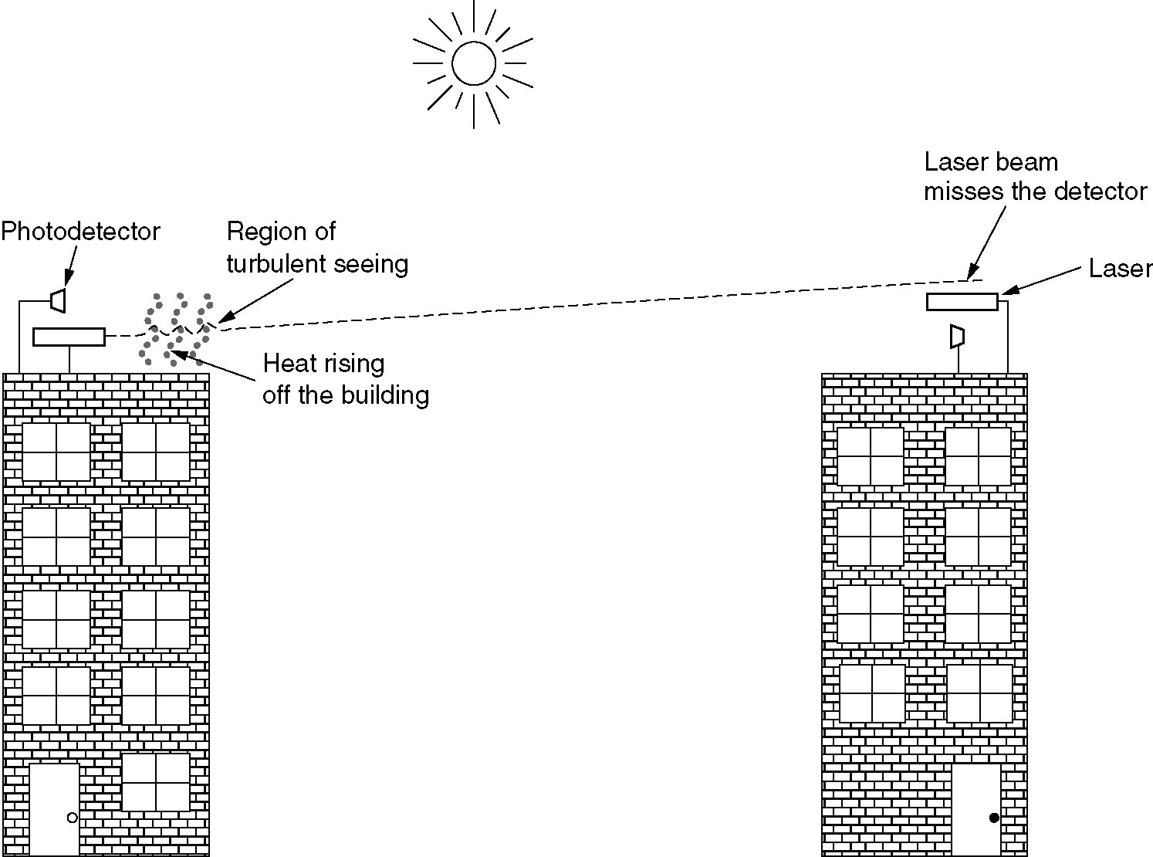
Lightwave Transmission
Convection currents can interfere with laser communication systems.

Slide 80
Wireless Transmission
The Electromagnetic Spectrum
Radio Transmission
Microwave Transmission
Infrared and Millimeter Waves
Lightwave Transmission

Slide 81
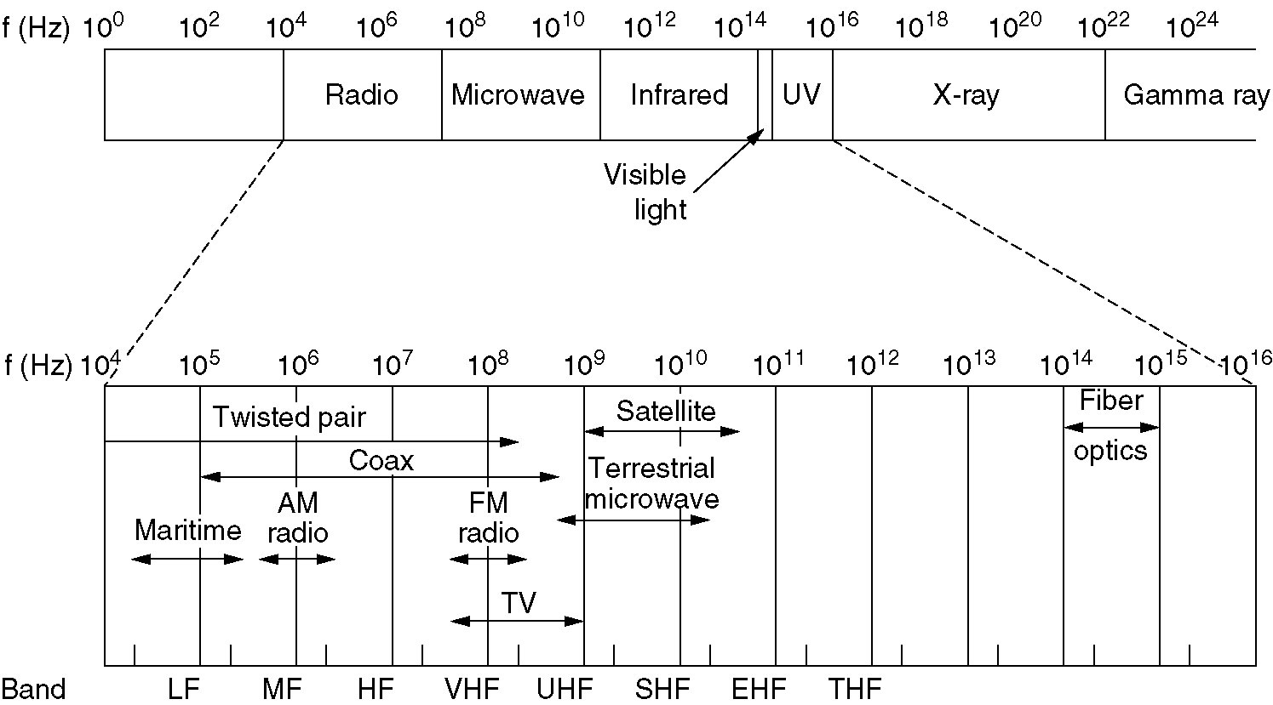
The Electromagnetic Spectrum
The electromagnetic spectrum and its uses for communication.

Slide 82
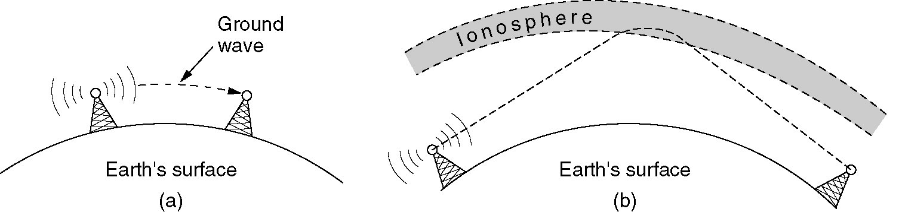
Radio Transmission
(a) In the VLF, LF, and MF bands, radio waves follow the curvature of the earth.
(b) In the HF band, they bounce off the ionosphere.

Slide 83
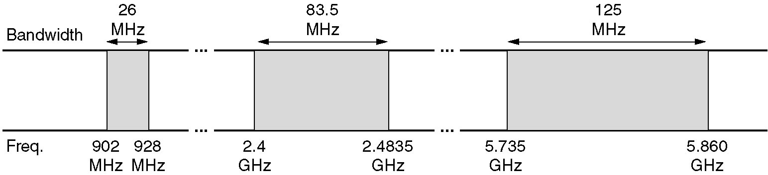
Politics of the Electromagnetic Spectrum
The ISM bands in the United States.

Slide 84
Lightwave Transmission
Convection currents can interfere with laser communication systems.
A bidirectional system with two lasers is pictured here.

Slide 85
Communication Satellites
Geostationary Satellites
Medium-Earth Orbit Satellites
Low-Earth Orbit Satellites
Satellites versus Fiber

Slide 86
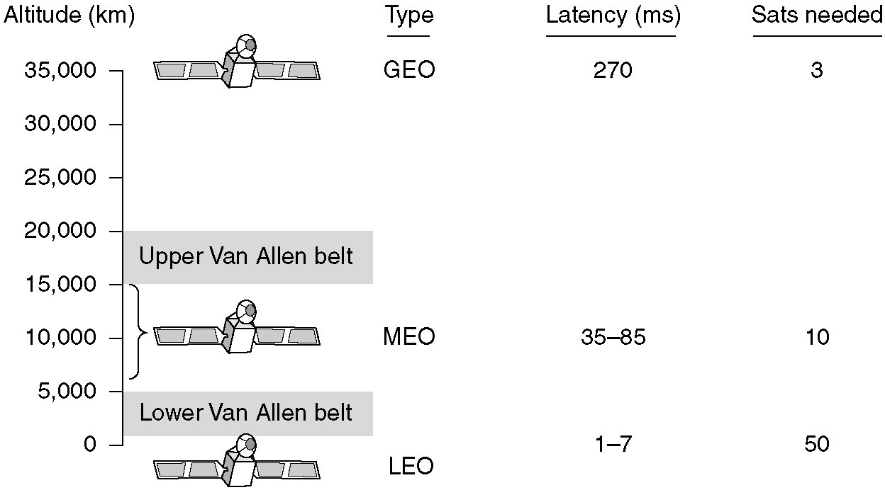
Communication Satellites
Communication satellites and some of their properties, including altitude above the earth, round-trip delay time and number of satellites needed for global coverage.

Slide 87
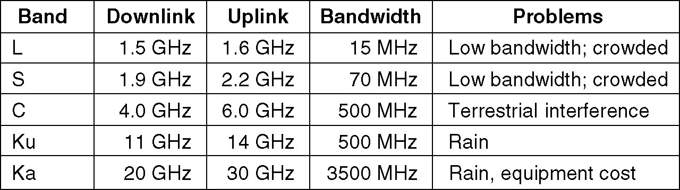
Communication Satellites (2)
The principal satellite bands.

Slide 88
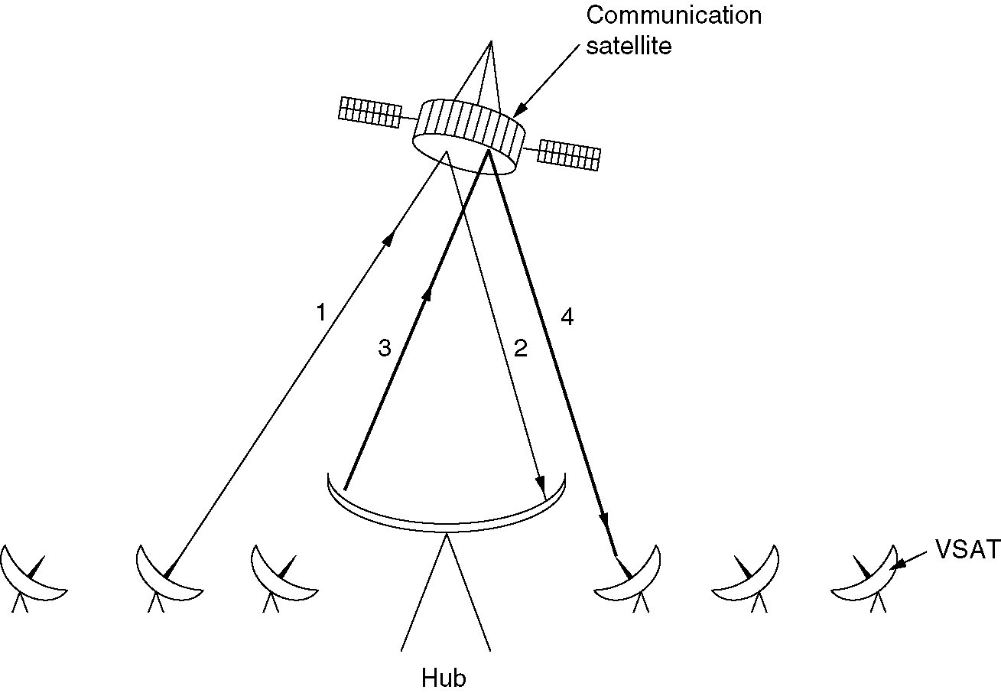
Communication Satellites (3)
VSATs using a hub.

Slide 89
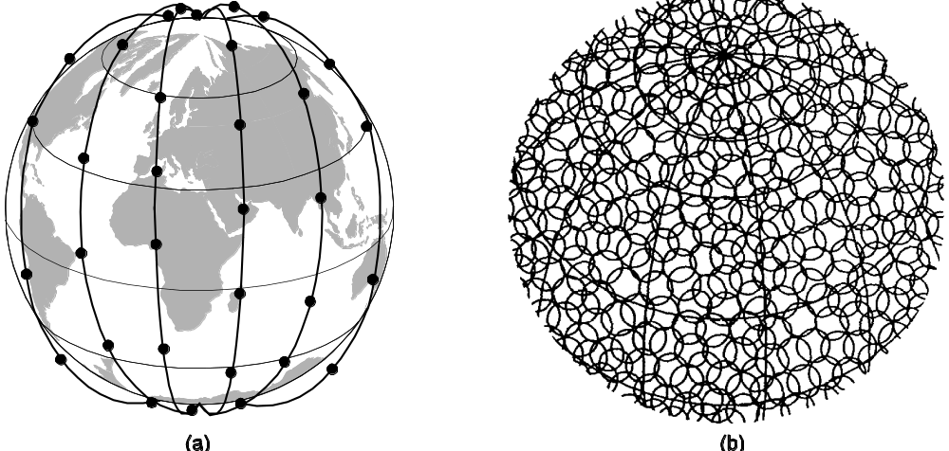
Low-Earth Orbit Satellites
Iridium
(a) The Iridium satellites from six necklaces around the earth.
(b) 1628 moving cells cover the earth.

Slide 90
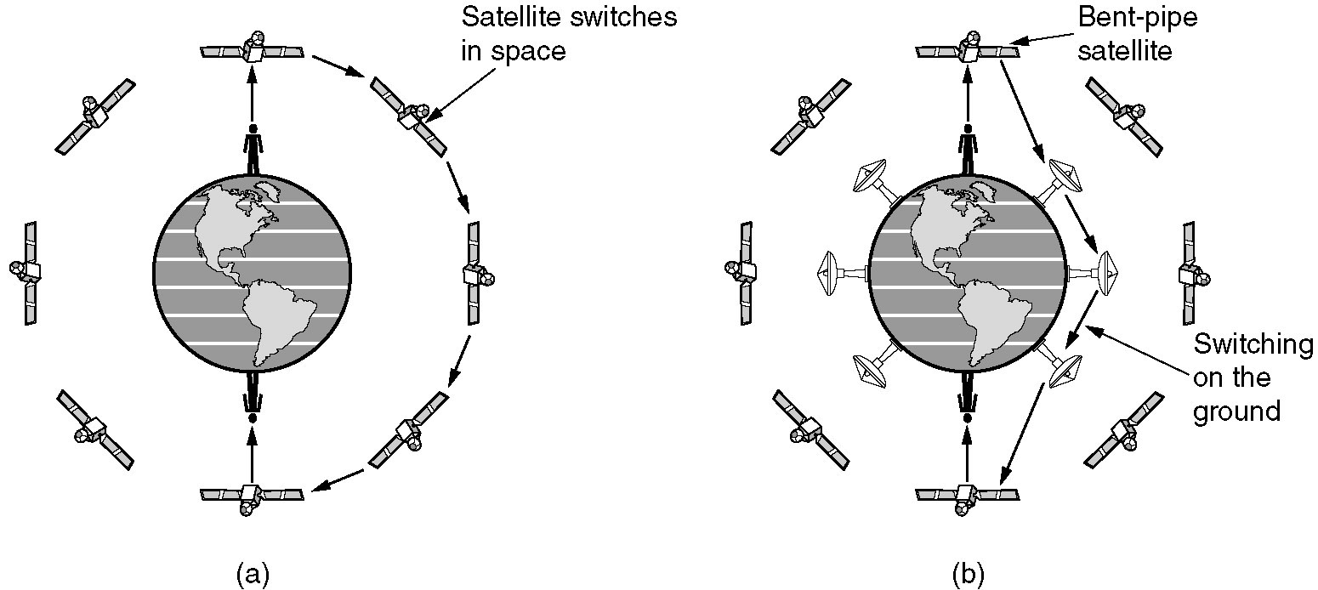
Globalstar
(a) Relaying in space.
(b) Relaying on the ground.

